Slide 1
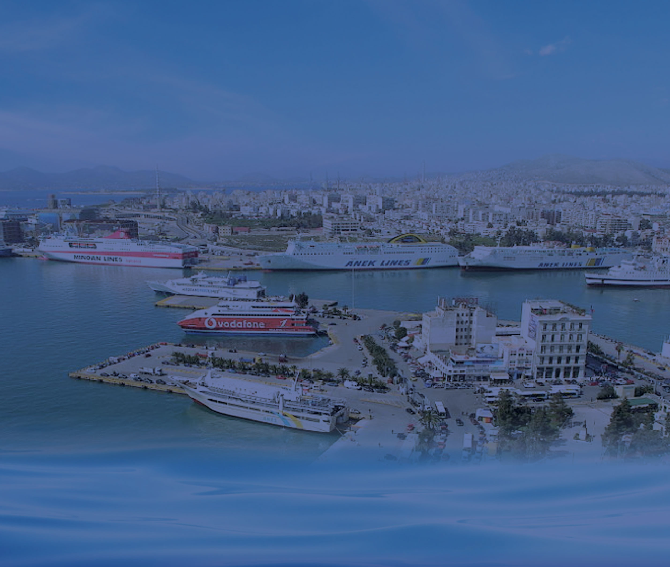






62nd World Conference ISSA
Athens 2017
Mr Nikolaos Mavrikos
Chairman of
Member of
CONFORMITY OF MANAGEMENT SYSTEM according to ELOT 1429/2008
www.ship-suppliers.gr

Slide 2

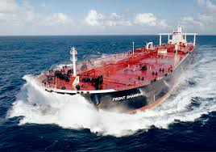


Φιλοσοφία
Quick Presentation of
Hellenic Ship Supplier Association was established in 1975
We represent 116 members
Most of our members have at least 20 years of experience and strong export Activity
Member’s turnover in 2016 was 260 millions Euros
They employ about 1.500 employees
They are Certified by ISO, HACCP, Authorized Economic Operator etc
We promote Greek products to ships
We are members of ISSA, OCEAN, Hellenic Cluster “Maritime Hellas”
We are certified for CONFORMITY OF MANAGEMENT SYSTEM according to ELOT 1429/2008
CONFORMITY OF MANAGEMENT SYSTEM according to ELOT 1429/2008
Notes:
To Change the image
1. Inside the gruop select the shape – Rignt Click > Format Picture > Fill > Select option „Picture or Texture Fill” > Select Your Photo and Close.

Slide 3
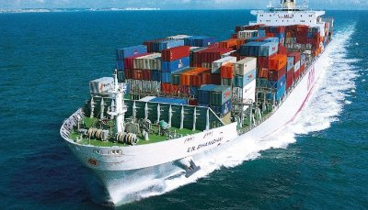
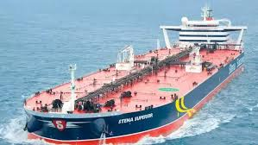
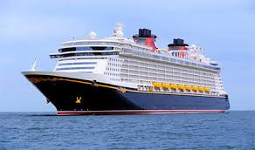
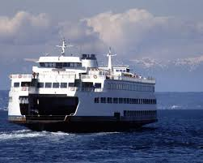
Φιλοσοφία
We supply all kinds of ships
Cargo
Tankers
Cruise
Ferry boats
Notes:
To Change the image
1. Inside the gruop select the shape – Rignt Click > Format Picture > Fill > Select option „Picture or Texture Fill” > Select Your Photo and Close.

Slide 4

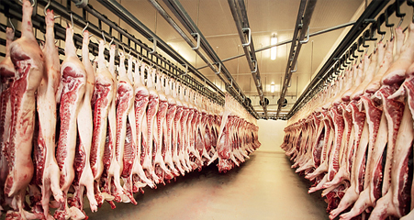





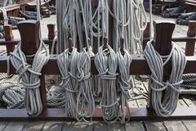
Φιλοσοφία
We supply with
Food Supplies
Equipment
Repair parts
Maintenance Parts
Safety Equipment
Notes:
To Change the image
1. Inside the gruop select the shape – Rignt Click > Format Picture > Fill > Select option „Picture or Texture Fill” > Select Your Photo and Close.

Slide 5

Suppliers in Greece
We do business without Banking System since 2009
We do business using our own funds
Despite the booming of cruising in Greece, ships only buy the necessary supplies
Due to the new management of Piraeus Port, the supply of Cargo has increased
Nevertheless, the supplying companies managed to survive and support shipping companies at all times
Notes:
To Change the image
1. Inside the gruop select the shape – Rignt Click > Format Picture > Fill > Select option „Picture or Texture Fill” > Select Your Photo and Close.

Slide 6

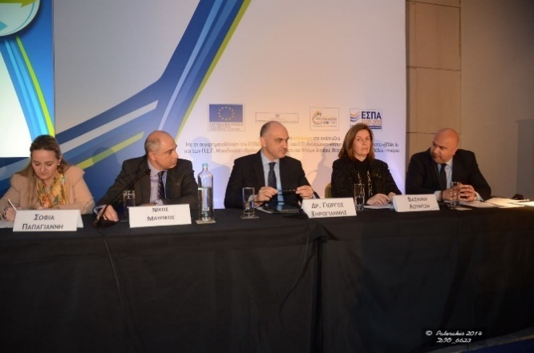
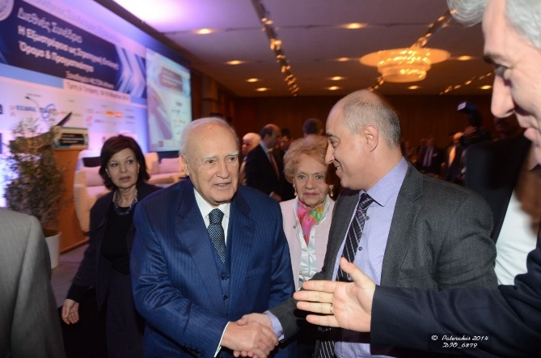
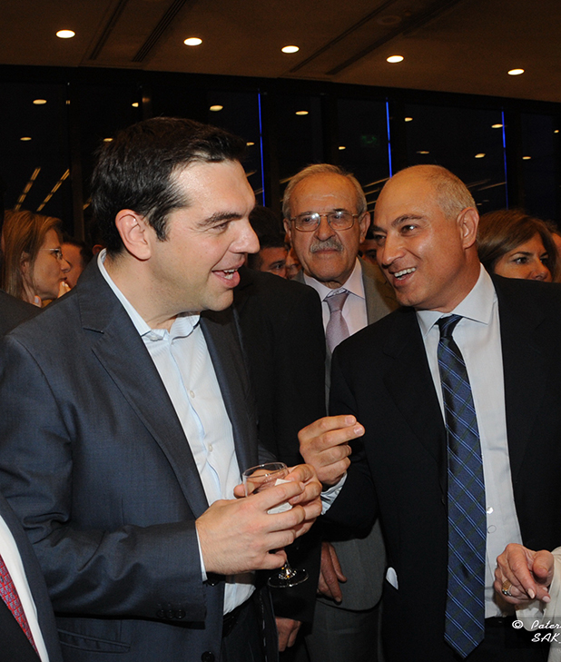
COOPERATION WITH
Piraeus Chamber of Commerce and Industry
Panhellenic Exporters Association
Custom General Directorate
Ministry of Finance
Notes:
Δεν είναι κάτι από αυτά που έχουμε συνηθίσει έως σήμερα

Slide 7
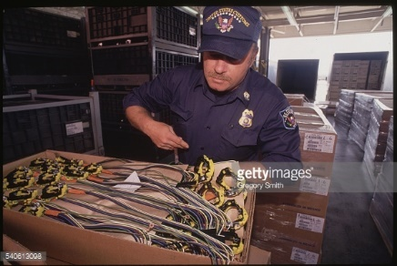
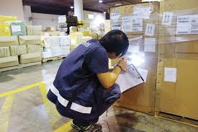

As HSSEA we have succeeded in
Modifying the legal institutional framework
Reducing guarantees
Reducing bureaucracy
Simplifying daily procedures
Enforcing the development of logistics
Notes:
Δεν είναι κάτι από αυτά που έχουμε συνηθίσει έως σήμερα

Slide 8

Actions of HSSEA
We send proposals and reports to Political Leaders
We cooperate on permanent basis with a “customs advisor”
We keep our members “up to date” with new laws and regulations
We organize training seminars
We motivate our members to participate in vocational trading seminars and to be certified.
We create a database with debt customers or suppliers in order to help our members.
Last year our Association received certification FOR CONFORMITY OF MANAGEMENT SYSTEM according to ELOT 1429/2008.
Notes:
Δεν είναι κάτι από αυτά που έχουμε συνηθίσει έως σήμερα

Slide 9
IT Infrastructure
«infrastructure»
Erp for Members Management
Facebook
Web Site
Forum
Notes:
To Change the image
1. Inside the gruop select the shape – Rignt Click > Format Picture > Fill > Select option „Picture or Texture Fill” > Select Your Photo and Close.

Slide 10

International Presence of
Member of INTERNATIONAL SHIPSUPPLIERS & SERVICES ASSOCIATION (ISSA)
Member of EUROPEAN SHIP SUPPLIERS ORGANISATION (OCEAN)
Member of Hellenic Cluster “Maritime Hellas”
Notes:
Δεν είναι κάτι από αυτά που έχουμε συνηθίσει έως σήμερα

Slide 11












Members of Sponsors of directory
Notes:
To Change the image
1. Inside the gruop select the shape – Rignt Click > Format Picture > Fill > Select option „Picture or Texture Fill” > Select Your Photo and Close.

Slide 12











Other Sponsors of directory
Notes:
To Change the image
1. Inside the gruop select the shape – Rignt Click > Format Picture > Fill > Select option „Picture or Texture Fill” > Select Your Photo and Close.

Slide 13
Thank you for your kind attention
Nikolaos Mavrikos
Chairman
ww.ship-suppliers.gr
Notes:
To Change the image
1. Inside the gruop select the shape – Rignt Click > Format Picture > Fill > Select option „Picture or Texture Fill” > Select Your Photo and Close.

